Slide 2
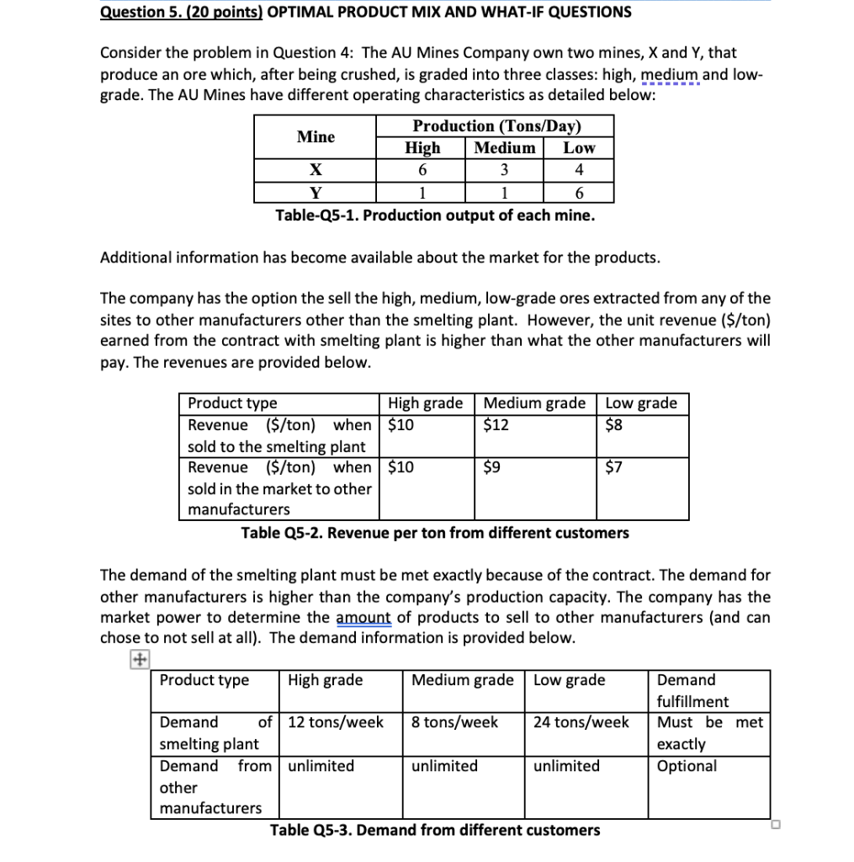

Slide 3
Reliance New Energy Limited acquires assets of Lithium Werks cobalt-free lithium battery technology company And FARADION The British sodium-ion battery technology company Faradion has been bought up by Reliance New Energy Solar (RNES), a wholly-owned subsidiary of Reliance Industries.

Slide 4
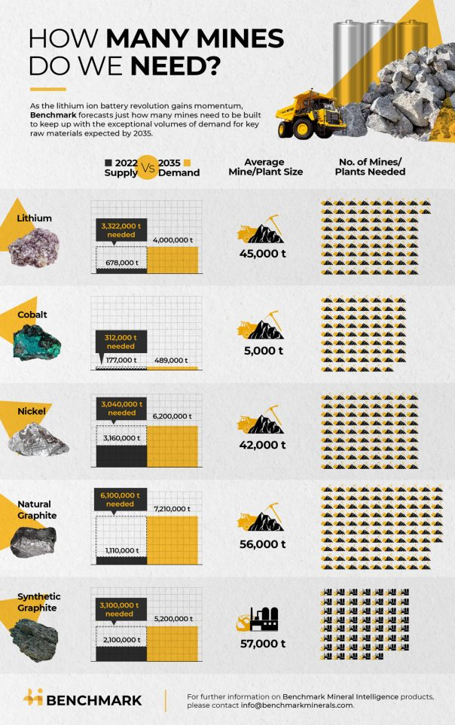

Slide 5
LITHIUM RUSH
To meet the world’s lithium requirements would require 74 new lithium mines with an average size of 45,000 tonnes by 2035, according to Benchmark. Including forecast volumes from recycled lithium, however, it’s around 59 mines.
Since mines take at least five years to build these mines will need to be in operation by 2033, according to Cameron Perks, an analyst at Benchmark.
“That’s around 59 lithium mines up and running in just over 10 years,” he said.
Australia is set to remain the dominant producer of lithium this decade, according to Benchmark. There are currently over 13 lithium mines producing lithium-containing spodumene rock, over 75% of which is refined in China.

Slide 6
Analysis from Benchmark Mineral Intelligence's raw material forecasts shows at least 384 new mines for graphite, lithium, nickel and cobalt are required to meet demand by 2035, based on average mine sizes in each industry. Taking into account recycling of raw materials, the number is around 336 mines
For #lithium, the world will require 74 new lithium mines with an average size of 45,000 tonnes by 2035, or 59 if recycling rates ramp up as expected
Issues will also be faced in the midstream, with the need for aggressive expansion of lithium refinery facilities able to produce consistent, battery grade, qualified lithium chemicals being another significant hurdle
Looking to #graphite, a total of an estimated 97 natural flake graphite mines will need to be built, assuming an average size of 56,000 tonnes a year, whilst a further 54 synthetic graphite plants with an average size of 57,000 tonnes will also be required
How the balance of synthetic vs natural graphite plays out in China compared to the rest of the world will also play a role, but either way a significant volume of raw materials will be required to meet #anode demand from the #EV industry

Slide 7
NICKEL AND COBALT
Yet another 72 mining projects with an average size of 42,500 tonnes will be required to meet battery demand for refined nickel, according to Benchmark.
Recycling, however, is set to have the biggest impact on cobalt mining. Without recycling, the world would need to build 62 new cobalt mining projects of 5,000 tonnes each by the end of 2035.
With forecast recycled volumes, however, that number falls by almost half to 38.

Slide 8
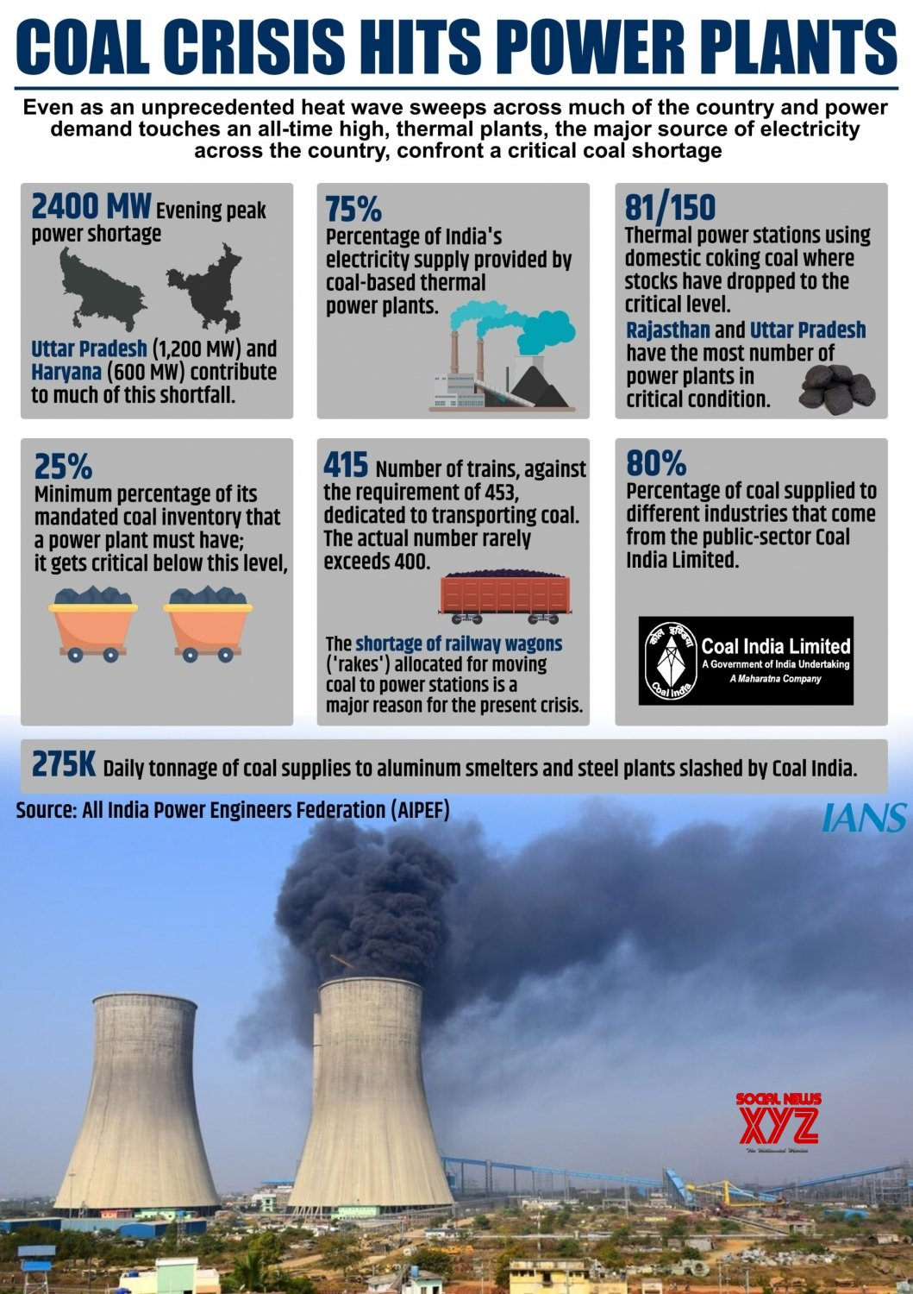

Slide 9
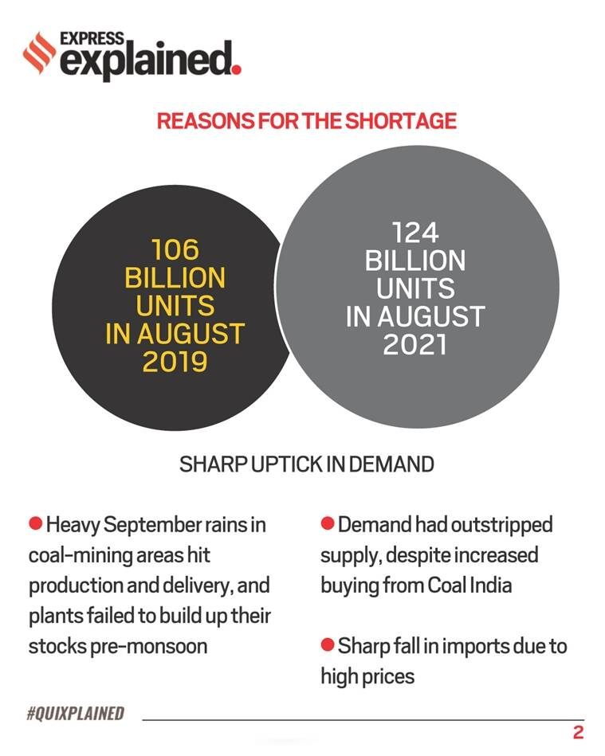
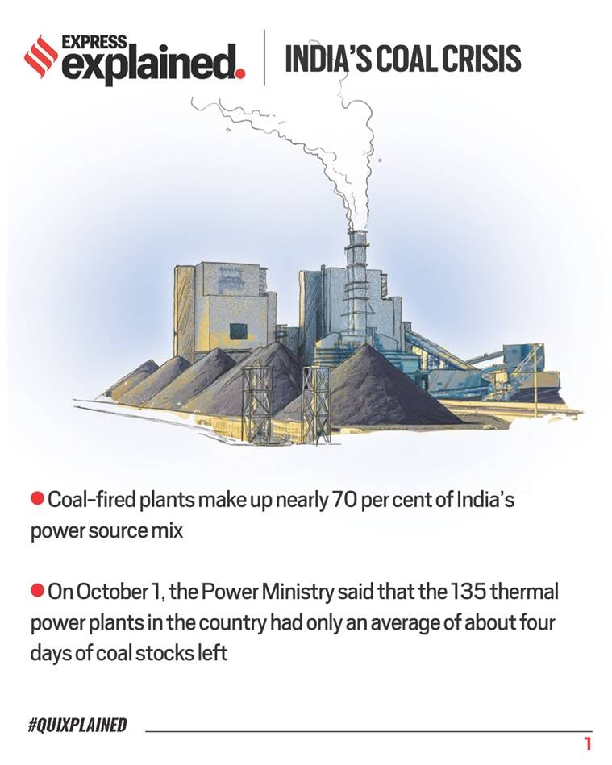

Slide 10
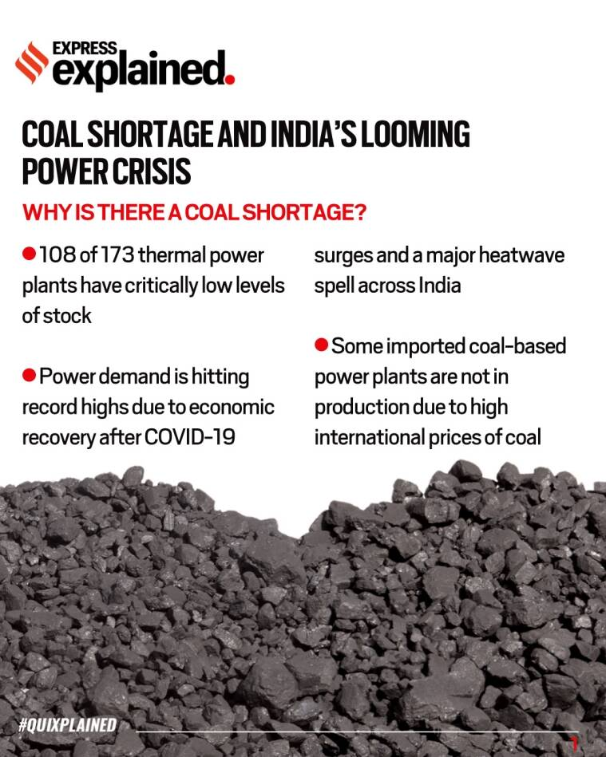

Slide 11
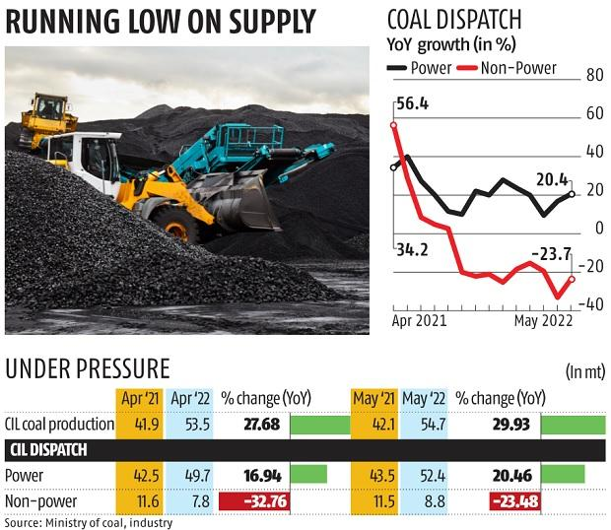

Slide 12
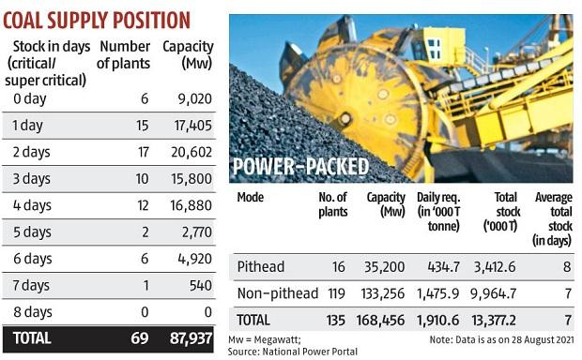

Slide 13
Non-pithead plants & pithead plants
pit-head power plant means any captive or stand-alone power station having captive transportation system for its exclusive use for transportation of coal from the loading point at the mining end, up to the uploading point at the power station without using the normal public transportation system;
Non pit-head power plant Thermal power plants located away from mines

Slide 14
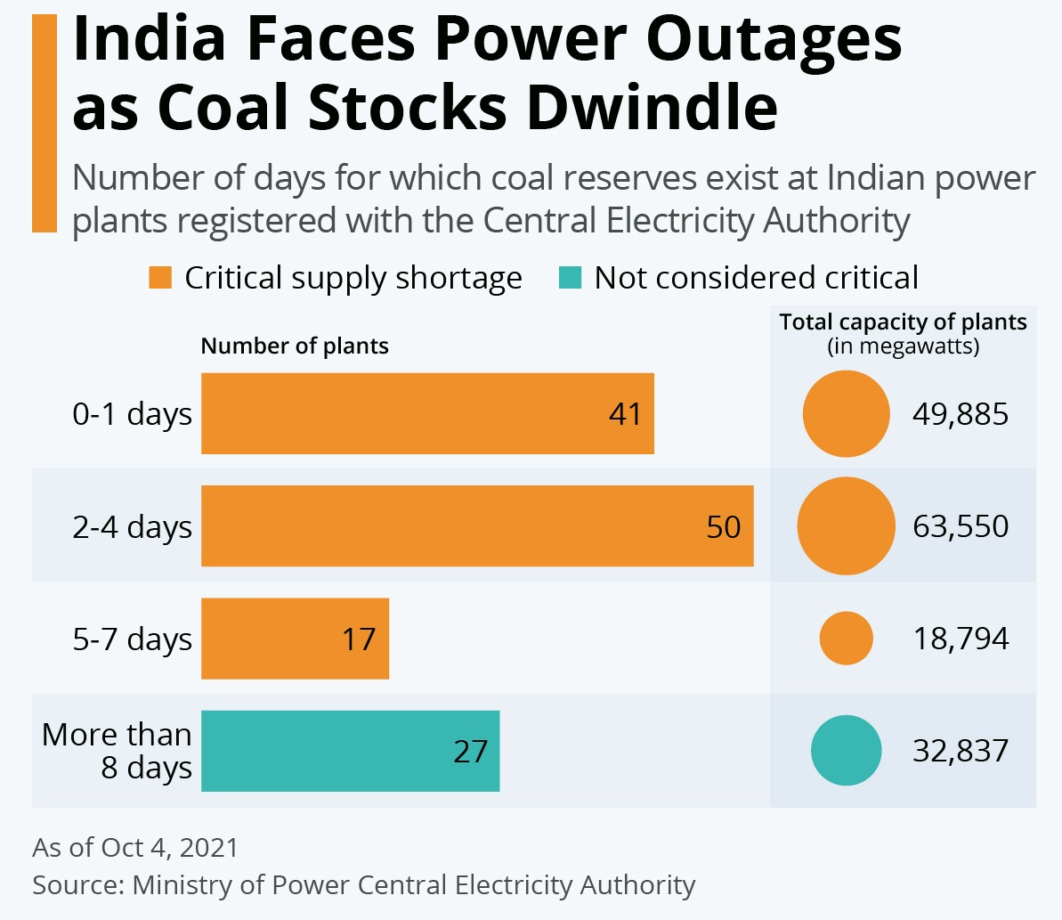

Slide 15
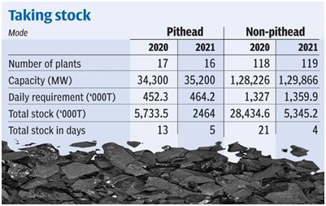

Slide 16
